Slide 1
Understanding
Linked Art
https://linked.art/
Rob Sanderson
Senior Director for Digital Cultural Heritage
robert.sanderson@yale.edu

Slide 2
Overview
Introduction (15)
Principles and Processes (10)
The Linked Art Data Model (40, 15 break, 40)
Discuss and Apply the Model (15)
APIs to Implement Linked Art (20)
Discussion (15)

Slide 3
1. Introduction
Goals and Vision of Linked Art
History
Foundational Theory
Selected Implementations
Current Status

Slide 4
What is Linked Art?
A Linked Open Usable Data specification, collaboratively designed to work across cultural heritage organizations, allowing easy publication and use of our knowledge.
Linked Art provides a Standards based metadata profile,
… which Consistently solves problems from real data,
… is designed for Usability and ease of implementation, … which are prerequisites for Sustainability

Slide 5



Vision of a Connected World
We can all benefit by working together independently, via standards
Notes:
Why Linked Art?

Slide 6

Brief History of Time
American Art Collaborative
AAC Target Model
Getty Extensions
Kress, AHRC Grants, F2F 1-3
CIDOC WG Approved
F2F 4,5
1.0 Specs
2014
2015
2016
2017
2018
2019
2020
2021
2022
2023

Slide 7
Baseline Theory You Need to Know
Knowledge Graph A method of managing data by describing entities, connected via named, semantic relationships into a coherent network or graph
Entity A thing (physical, conceptual, or beyond) of interest e.g. a physical painting; the concept of oil paint
Relationship The way in which two entities are connected e.g. the painting has a material of oil paint

Slide 8
Data Model Standards
Conceptual Model
Abstract way to think about the world, holistically, consistently and coherently
Ontology
Shared set of terms to encode that thinking in a logical, machine-actionable way
Vocabulary
Curated set of sub-domain specific terms, to make the ontology more concrete
Model
encoded by
Ontology
refined by
Vocabulary

Slide 9
Implementation Standards
A Profile is a selection of appropriate abstractions, to encode the scope of what can be described.
An API is a selection of appropriate technologies, to give access to the data managed using the profile.
Model
encoded by
specialized by
available by
Ontology
API
Profile
refined by
Vocabulary

Slide 10
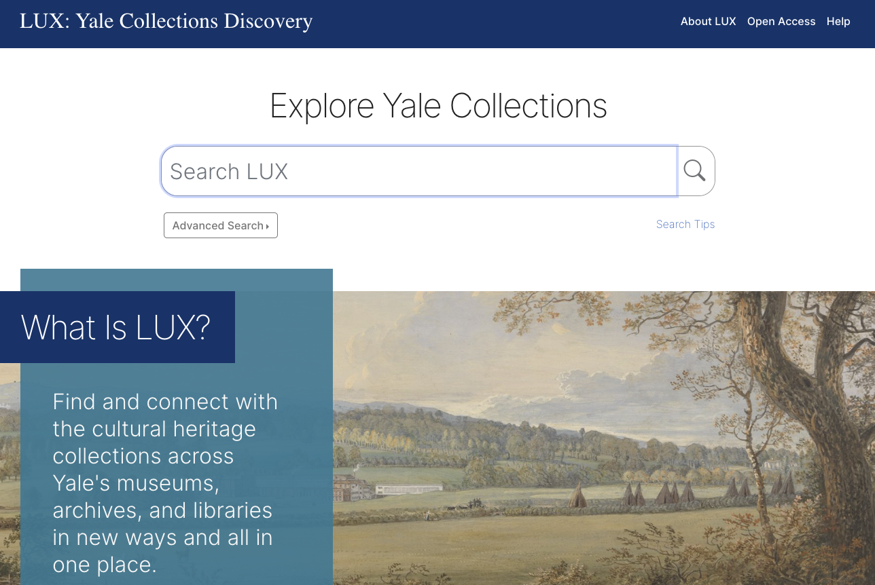
LUX – Yale Collections Discovery

Slide 11
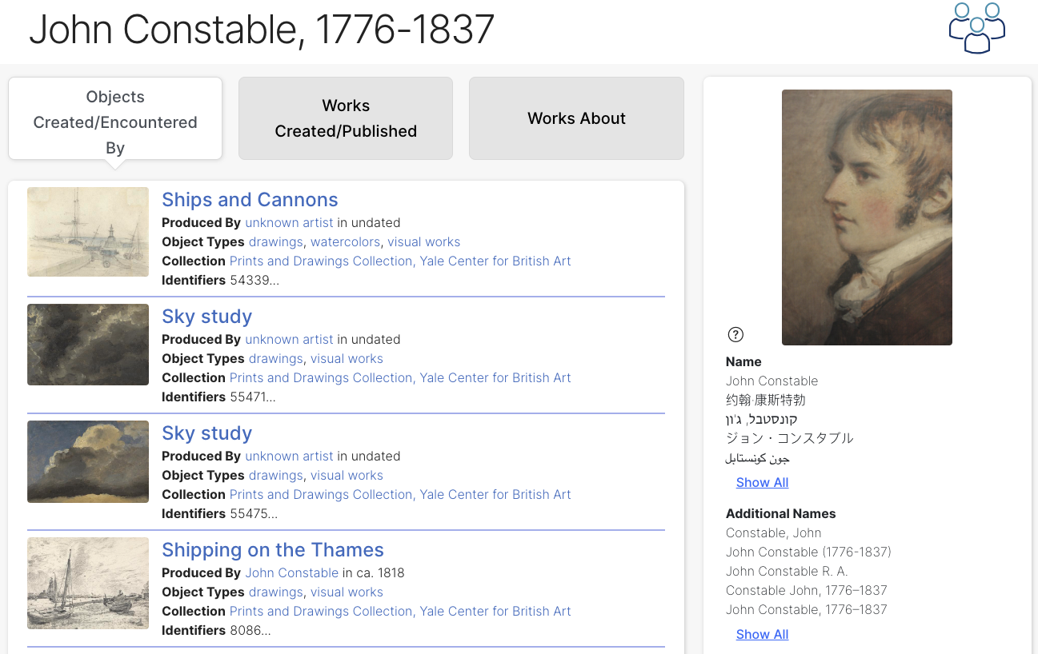
LUX – Yale Collections Discovery

Slide 12
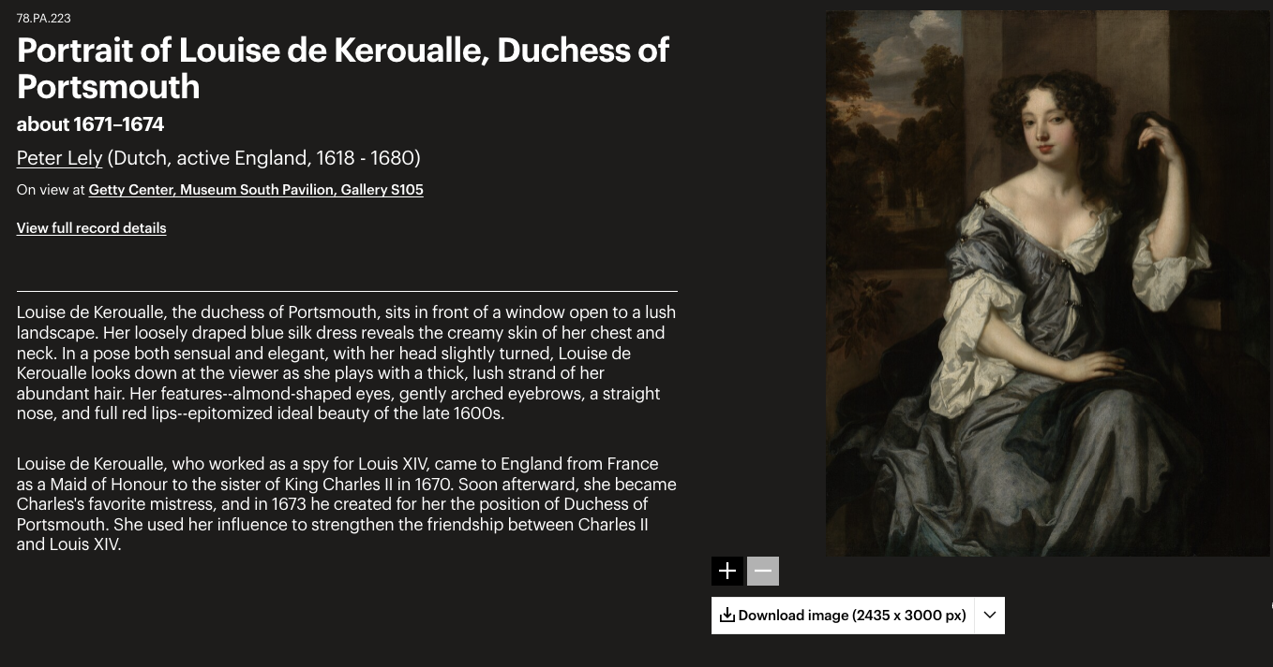
Getty Museum

Slide 13
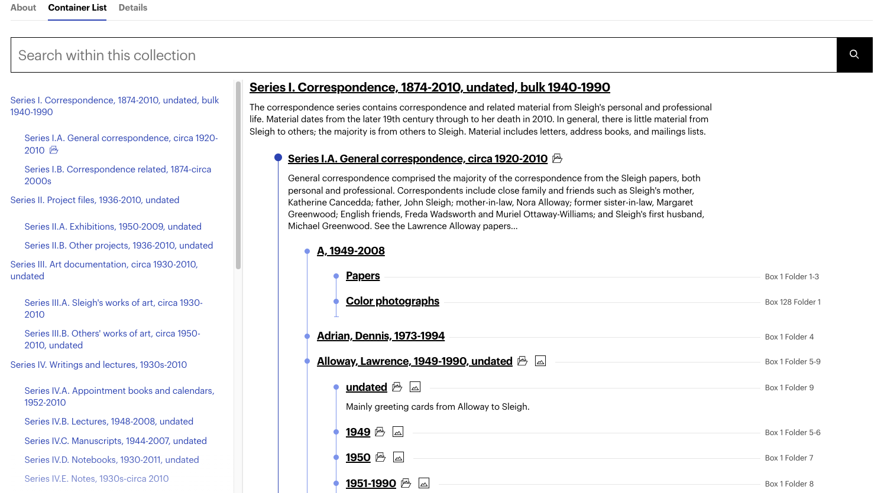
Getty Research Collections Viewer

Slide 14
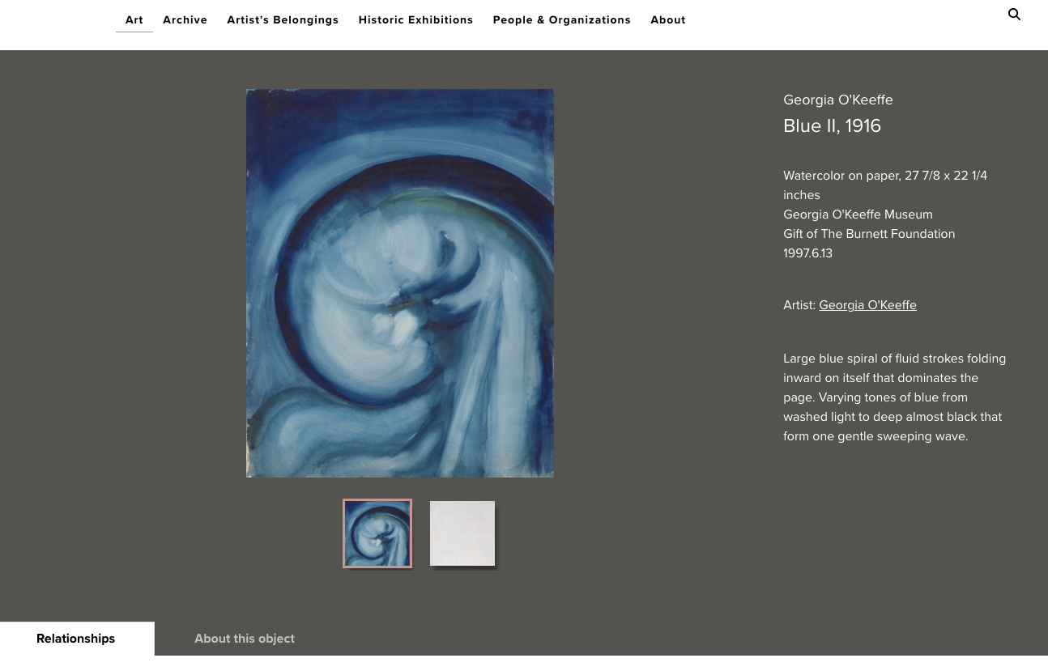
O’Keeffe Museum

Slide 15
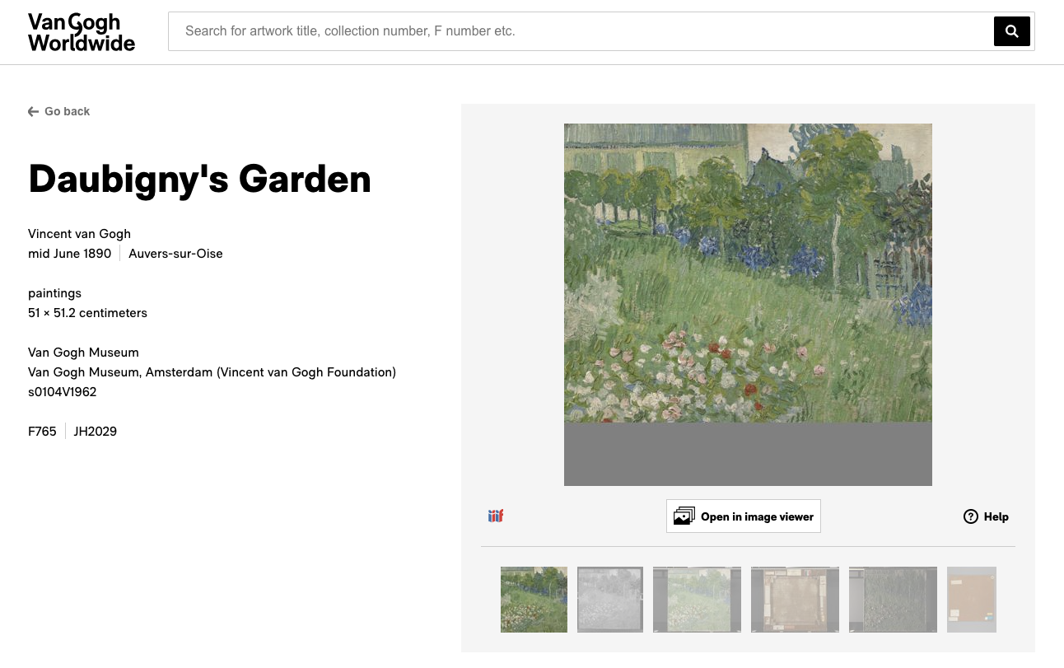
Van Gogh World Wide

Slide 16
Where We Are Today?
Specifications have a solid, stable core
Still some changes around the edges
Documentation needs to be finalized
Multiple implementations in Production
All use slightly different versions
Some have extensions to be ratified or replaced

Slide 17
Where Are We Headed?
Finalize 1.0 specifications
Model and API + vocabulary recommendations
No changes (barring typos) for at least 2 years
Implementations
Update to use 1.0 specs (plus any necessary extensions)
Community services available, eg validate, reconcile
Multi institution aggregation demonstrator

Slide 18
Documentation
https://linked.art/
Model
API
Community

Slide 19
2. Principles and Processes
Usability
Interoperability
Design Principles
Community

Slide 20
What is Linked Art? (redux)
A Linked Open Usable Data specification, collaboratively designed to work across cultural heritage organizations, allowing easy publication and use of our knowledge.
Linked Art provides a Standards based metadata profile,
… which Consistently solves problems from real data,
… is designed for Usability and ease of implementation, … which are prerequisites for Sustainability
Notes:
Don’t re-read, just note Usability as core to our principles

Slide 21
What is Data Usability?
“
”
… usability is the degree to which [a thing] can be used by specified consumers to achieve [their] quantified objectives with effectiveness, efficiency, and satisfaction in a quantified context of use.
who
what
how
where
Usability is dependent on the Audience
https://en.wikipedia.org/wiki/usability

Slide 22
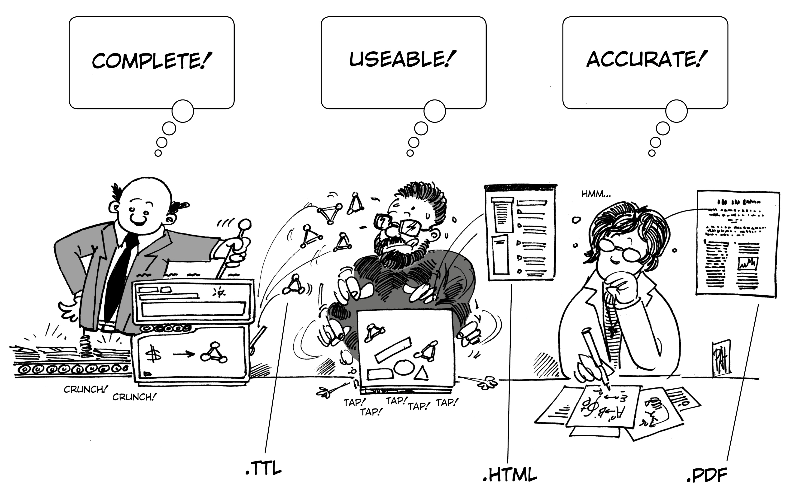
LOUD’s Audience is Developers

Slide 23
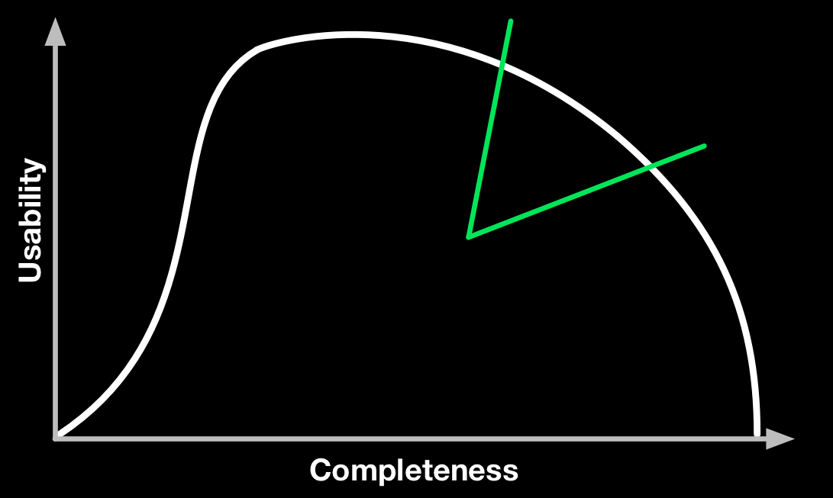
Usable vs Complete: Target Zone

Slide 24
Interoperability?
Syntactic Interoperability In scope! Do the messages passed between client and server conform to the specifications?
Semantic Interoperability In scope! When we use the concept for “painting” do we mean (approximately) the same thing?
Single, Unique Identity for each Entity Out of scope! Multiple representations are necessary, useful, and important

Slide 25
Design Principles for Usability
Scope design through shared use cases
Design for international use
As simple as possible, but no simpler
Make easy things easy, complex things possible
Avoid dependency on specific technologies
Use REST / Don’t break the web
Design for JSON-LD, using LOD principles
Follow existing standards & best practices, when possible
Don’t fear the network
Define success, not failure (for extensibility)
https://iiif.io/api/annex/notes/design_patterns/, https://linked.art/api/1.0/principles/

Slide 26
Design Specifics
Trivial to Implement Possible to implement with hand crafted files on disk
Consistency across Representations Each relationship in only one document
Division of Information across Representations From the many to the few, and easy to determine
Identity and URI Requirements One-to-one relationships are embedded, no URIs The URIs for records do not have any internal structure
https://linked.art/api/1.0/principles/

Slide 27
Linked Art Community Process
Calls every two weeks via Zoom
Wednesday 8am LA, 11am NY, 4pm UK, 5pm EU
Agendas and notes in Google Docs
Slack channel, Google Group, Face to Face meetings
Issues and the specifications are managed via github: https://github.com/linked-art/linked.art
Please Participate!

Slide 28
3. Linked Art Data Model
Base Patterns
Classes of Entity Break! :)
Shared Properties and Constructs
Class Specific Details
Note: This is the abstract model, not the API implementation

Slide 29
3.1. Base Patterns
URI, Class and Label
Class or Classification?
Names and Identifiers
Statements
Activities
Partitioning

Slide 30
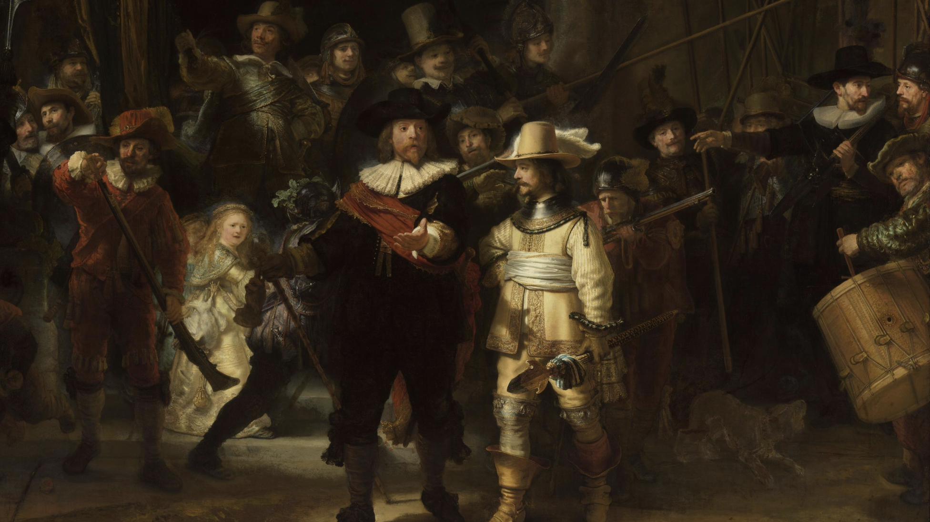
Running Example: The Night Watch

Slide 31
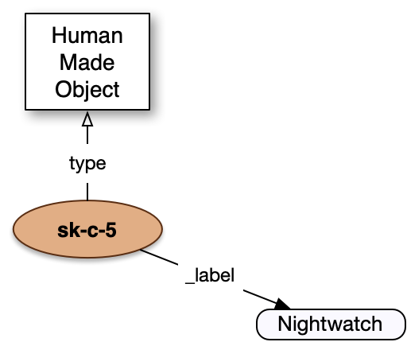
URI, Class, Label
{
"@context": "https://linked.art/ ns/v1/linked-art.json",
"id": "https://rijks.nl/o/sk-c-5",
"type": "HumanMadeObject",
"_label": "Nightwatch"
}

Slide 32
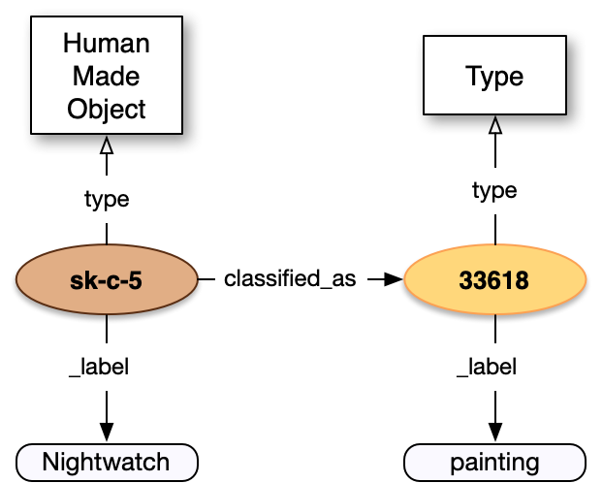
Class or Classification?
{
"@context": "https://linked.art/ ns/v1/linked-art.json",
"id": "https://rijks.nl/o/sk-c-5",
"type": "HumanMadeObject",
"_label": "Nightwatch",
"classified_as": [{ "id": "https://…/300033618", "type": "Type", "_label": "painting" }]
}

Slide 33
Sidebar on Vocabulary
We typically use Getty’s AAT – Art & Architecture Thesaurus
Terms fall into three categories:
Required: You must use the term to be considered valid. Example: “Primary Name”
Recommended: You should use the term unless there’s a reason not to. Example: “Painting”
Listed: You can use the term if you want, no pressure. Example: “Village”

Slide 34
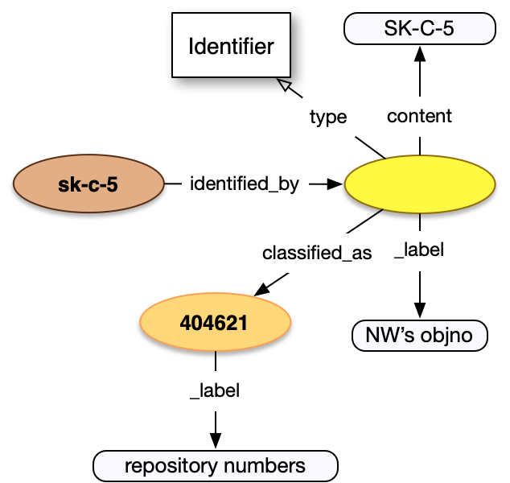
Names and Identifiers
{
"id": "https://rijks.nl/o/sk-c-5", "type": "HumanMadeObject", "_label": "Nightwatch",
"identified_by":[{
"type": "Identifier", "_label": "NW’s objno",
"content": "SK-C-5",
"classified_as": [{ "id": "https://…/300404621", "type": "Type", "_label": "repository number" }]
}] }

Slide 35
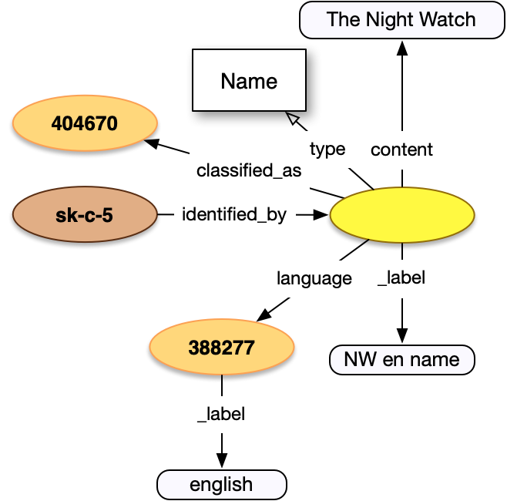
Names and Identifiers
{
"id": "https://rijks.nl/o/sk-c-5", "type": "HumanMadeObject", "_label": "Nightwatch",
"identified_by":[{ "type": "Name", "_label": "NW en name", "content": "The Night Watch",
"classified_as": […],
"language": [{ "id": "https://…/300388277", "type": "Language", "_label": "english" }]
}] }

Slide 36
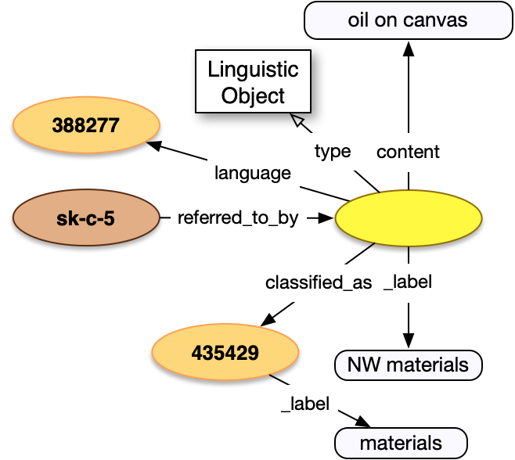
Statements
{
"id": "https://rijks.nl/o/sk-c-5",
"type": "HumanMadeObject",
"_label": "Nightwatch",
"referred_to_by":[{ "type": ”LinguisticObject", "_label": "NW materials", "content": "oil on canvas",
"language": […],
"classified_as": [{ "id": "https://…/300435429", "type": "Type", "_label": "materials" }]
}] }

Slide 37
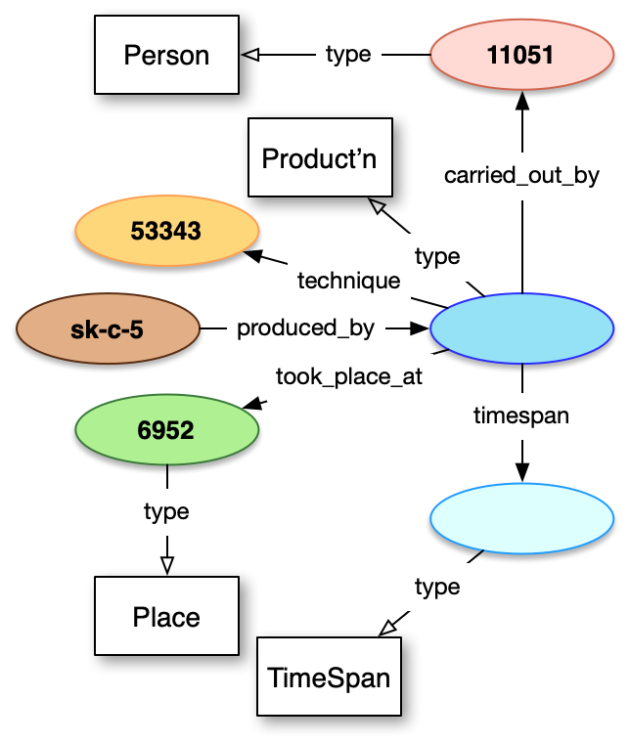
Activities (+diagram colors)
{
"id": "https://rijks.nl/o/sk-c-5",
"produced_by":{ "type": "Production", "carried_out_by": [{ "id": "https://…/500011051", "type": "Person"}], "took_place_at": [{ "id": "https://…/7006952", "type": "Place"}],
"technique": [{ "id": "https://…/300053343", "type": "Type"}],
"timespan": {…}
} }

Slide 38
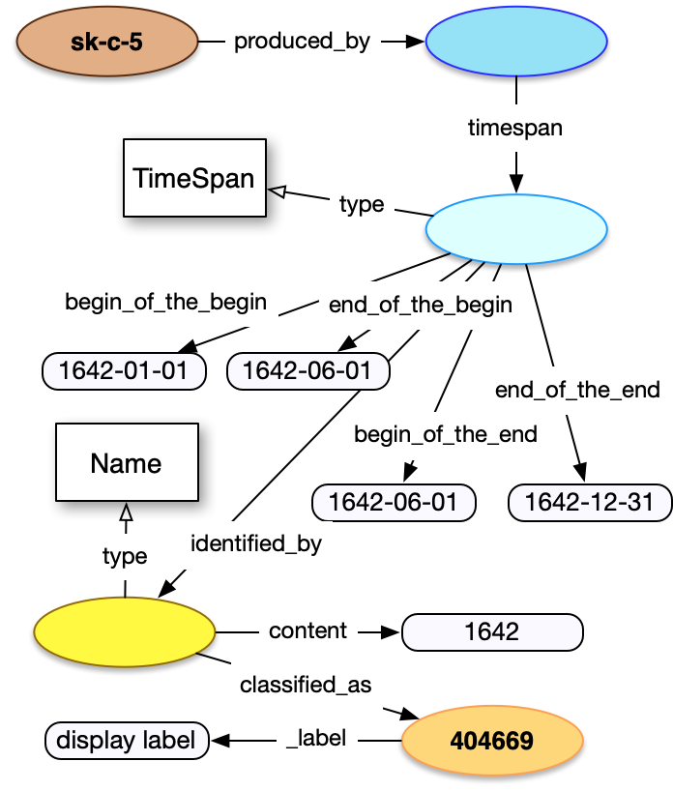
TimeSpans
{
"id": "https://rijks.nl/o/sk-c-5",
"produced_by":{ "type": "Production", "timespan": { "type": "TimeSpan", "begin_of_the_begin":”1642-01-01”, "end_of_the_begin":”1642-06-01”, "begin_of_the_end":”1642-06-01”, "end_of_the_end": ”1642-12-31", "identified_by":[{ "type": "Name", "content": ”1642", "classified_as": [{…}] }
} }

Slide 39
Partitioning Everywhere
To be more specific about an aspect of some entity, we need to describe the individual part with that aspect
A frame is part of a Painting (physical things)
A digital image is part of a digital document (digital)
A city is part of a county (place)
A chapter is part of the full text (language)
A motif is part of an image (visual)
A month is part of a year (temporal)
A concept has a broader concept (types)
An entity is a member of a collection (set/group membership)

Slide 40
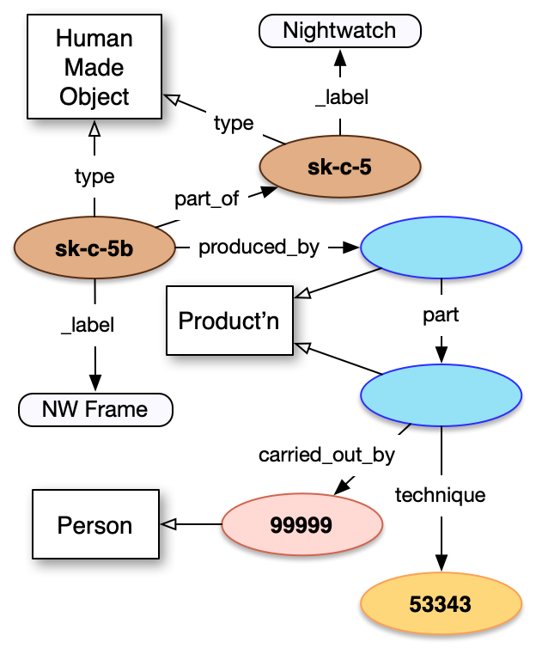
Partitioning
{
"id": "https://rijks.nl/o/sk-c-5b", "type": ”HumanMadeObject", "part_of": [{ "id": "https://rijks.nl/o/sk-c-5", }], "produced_by":{ "type": "Production", "part": [{
"type": "Production", "technique": [{ "id": "https://…/300053343”}] "carried_out_by": [{ "id": "https://…/500099999”}] }] } }

Slide 41
3.1- Take Home Summary
The URI identifies the entity and record on the web, Identifiers are institutional strings within the record
Small number of classes (ontology), and large number of classifications (vocabulary)
Names, Identifiers, Statements, Classifications are core, and available for every entity
Activities and Partitioning let us connect entities together and be as specific as needed

Slide 42
3.2. Classes of Entity
Objects: Physical and Digital
Works: Abstract, Textual and Visual
Actors: People and Groups
Places
Concepts: Type, Language, Material, Currency and Unit
Sets
Activities: Provenance and Exhibitions

Slide 43
Objects: Physical and Digital
HumanMadeObject A physical thing you can touch (even fossils, meteorites)
DigitalObject A file on a computer somewhere
Objects are individuals, not series or collections. Both can carry the same text or image, such as The Night Watch (physical) and the 717 Gigapixel photograph (digital) … and a t-shirt from the gift shop (physical)

Slide 44
Works: Abstract, Textual and Visual
PropositionalObject An abstract work, not textual or visual (e.g. exhibition idea)
LinguisticObject A textual work (e.g. the text of the Lord of the Rings)
VisualItem A visual work (e.g. the image of The Night Watch)
Objects carry Textual Works, or show Visual Works.

Slide 45
Actors: People and Groups
Person An individual capable of taking intentional action (humans)
Group More than one Person capable of collective action
We treat non-humans that are responsible for activities as “Person”s for the few times we need this.

Slide 46
Places
Place A fixed geographic location, describable using lat/long
Places are points or areas in space, and not what might be physically present there.
E.g. The Yale Peabody Museum has a new building (a HumanMadeObject) at the same location (Place).

Slide 47
Concepts
Type A category or classification of any sort (landscape)
Language A human language (Dutch)
Material A classification of matter (oil paint, canvas)
MeasurementUnit A unit for understanding a dimension value (cm, seconds)
Currency A unit for understanding a monetary value (euro, dollars)

Slide 48
Sets
Set An unordered group of any other entities
A conceptual set of things, used for collections of objects, or anything else. Semantics geek note: E78 is only physical, and only “curated” sets actively preserved for a specific purpose. Insufficient in many ways, but a clear use case for Sets: Accessioned Performance Art

Slide 49
Provenance and Exhibitions
Activity Provenance: An activity that transferred ownership, custody or location of an object. Exhibition: An activity of arranging and displaying artworks.
These are complex activities with their own records and detailed structure, compared to Production or Publication. Won’t go through them today.

Slide 50
3.2 - Take Home Summary
Objects are different from and carry Works
Objects are physical or digital “things”
Works are intellectual image or language content
People, Groups and Places give context, and are entities in their own right with separate records
Concepts are necessary for clarity (e.g. classifications)
Activities are explicit and connect the other entities, unlike other data models

Slide 51

Break!

Slide 52
3.3. Shared Properties and Constructs
Equivalent Records
Related Digital Image
Related Digital Content
Dimensions
Beginning (and End) of Existence
Use in Activities
Other Relationships and Assertions

Slide 53
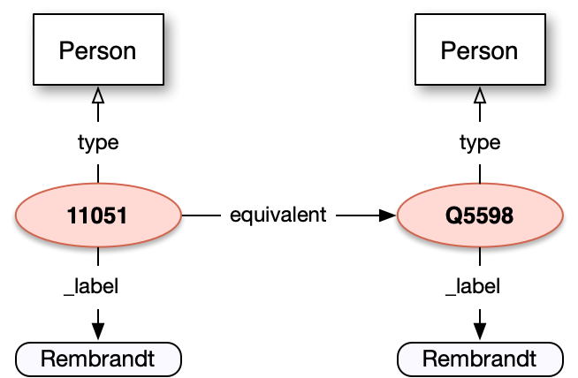
Equivalence
{
"id": "https://…/ulan/500011051", "type": "Person", "_label": "Rembrandt", "equivalent": [{ "id": "https://wikidata…/Q5598", "type": "Person", "_label": "Rembrandt" }] }
Note for semantics geeks: This is not owl:sameAs or skos:exactMatch due to inference issues. Not every relationship can be transferred for sameAs, and CRM maps skos:Concept to E55_Type, making everything with an equivalent into a concept!

Slide 54
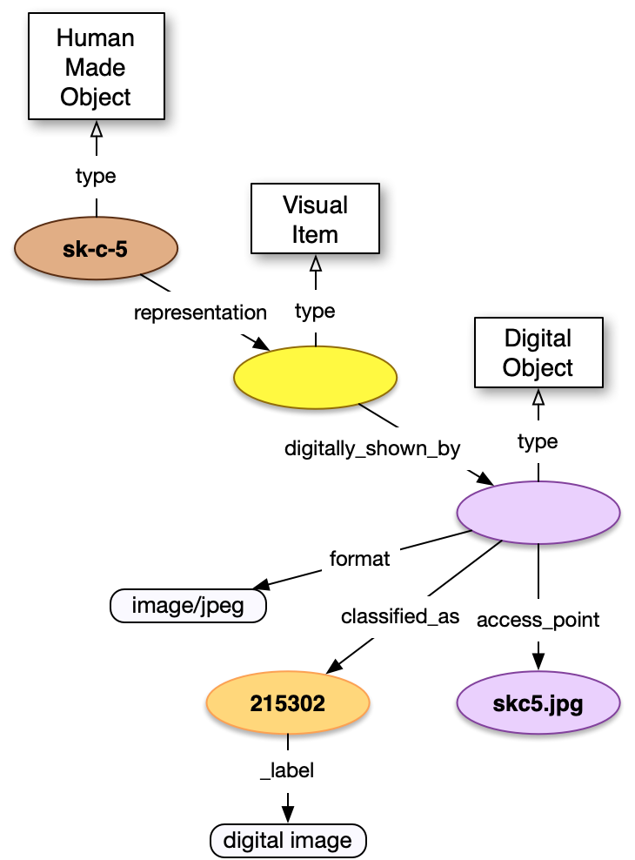
Related Digital Images
{
"id": "https://rijks.nl/o/sk-c-5", "type": "HumanMadeObject", "representation": [{ "type": "VisualItem", "digitally_shown_by":[{ "type": "DigitalObject", "format": "image/jpeg",
"classified_as": [{…}],
"access_point": [{
"id": "https://…/skc5.jpg", "type": "DigitalObject"}] }] }] }

Slide 55
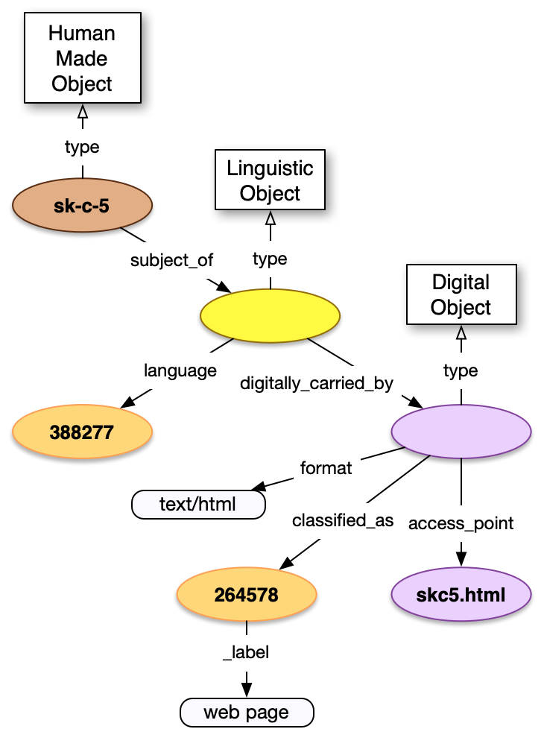
Related Digital Content
{
"id": "https://rijks.nl/o/sk-c-5", "type": "HumanMadeObject", "subject_of": [{ "type": "LinguisticObject", "language": [{…}], "digitally_carried_by":[{ "type": "DigitalObject", "format": "text/html",
"classified_as": [{…}],
"access_point": [{
"id": "https://…/skc5.html", "type": ”DigitalObject"}] }] }] }

Slide 56
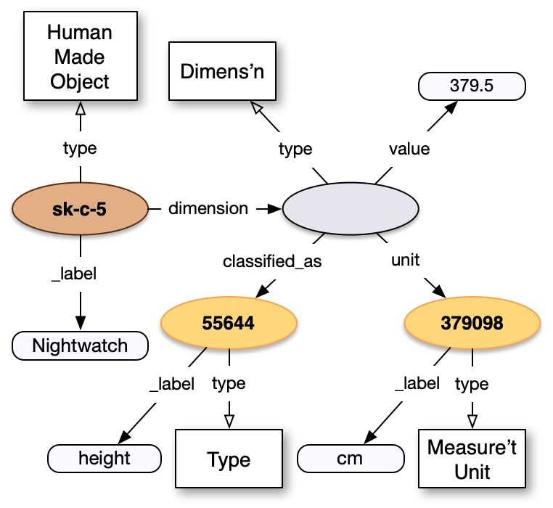
Dimensions
{
"id": "https://rijks.nl/o/sk-c-5", "type": ”HumanMadeObject", "dimension": [{ "type": "Dimension", "value": 379.5, "unit":[{ "id": "https://…/300379098", "type": "MeasurementUnit", "_label": "cm" }], "classified_as":[{ "id": "https://…/300055644", "type": "Type", "_label": "height" }] }] }

Slide 57
Beginnings of Existence
HumanMadeObject produced_by Production removed_by PartRemoval
DigitalObject created_by Creation
VisualItem, LinguisticObject created_by Creation
Concepts, Set created_by Creation
Person born Birth
Group formed_by Formation
Notes:
They don’t even have different properties! Birth is an event, not an Activity. Production is physical state change, whereas Creation isn’t. The “digital” thing is still somewhat conceptual -- we don’t try to model the physical storage device for example.

Slide 58
End of Existence
HumanMadeObject destroyed_by Destruction
Person died Death
Group dissolved_by Dissolution
Semantics Note, unfortunately for everyone – These are instantaneous events that can be caused_by some other event or activity, they’re not activities themselves. This is inherited from CIDOC-CRM.

Slide 59
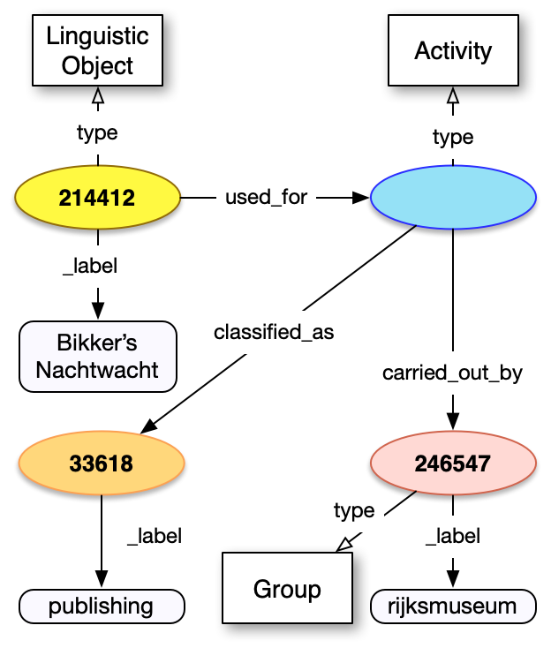
Use in Simple Activities
{
"id": "https://rijks.nl/t/214412", "type": "LinguisticObject", "used_for": [{ "type": "Activity", "classified_as":[{ "id": "https://…/300033618”, "type": "Type", "_label": "publishing" }], "carried_out_by":[{ "id": "https://…/500246547”, "type": "Group", "_label": "rijksmuseum" }] }] }

Slide 60
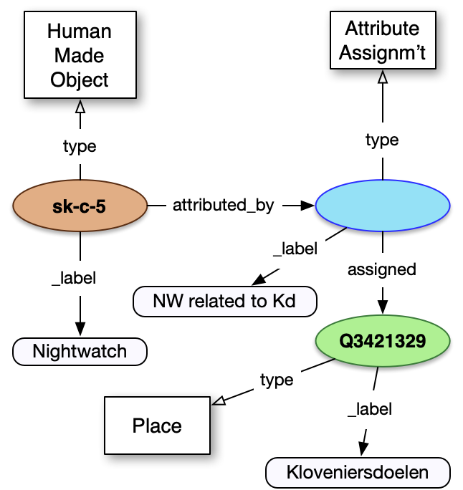
Arbitrary Connections
{
"id": "https://rijks.nl/o/sk-c-5", "type": "HumanMadeObject", "_label": "Nightwatch", "attributed_by": [{ "type": "AttributeAssignment", "_label": "NW related to Kd", "assigned":[{ "id": "https://…/Q3421329”, "type": "Place", "_label": "Kloveniersdoelen" }] }] }

Slide 61
3.3. Take Home Summary
Common patterns used across all classes for consistency, ease of understanding, and usability of the data
References to equivalent records, images, web pages and other data important for context and connecting the web
Beginning/End of Existence and other activities (e.g. publication) are embedded in the record
Model extension is possible via AttributeAssignment

Slide 62
3.4. Class Specific Details
Physical Object
Digital Object
Textual Work
Visual Work
Person and Group
Place
Sets and Concepts

Slide 63
Physical Object
made_of Material
carries LinguisticObject
shows VisualItem
current_location Place
current_owner Person / Group
current_custodian Person / Group
(everything else has already been covered!)
Notes:
Nightwatch: Owned by city of Amsterdam, Custodian: Rijksmuseum

Slide 64
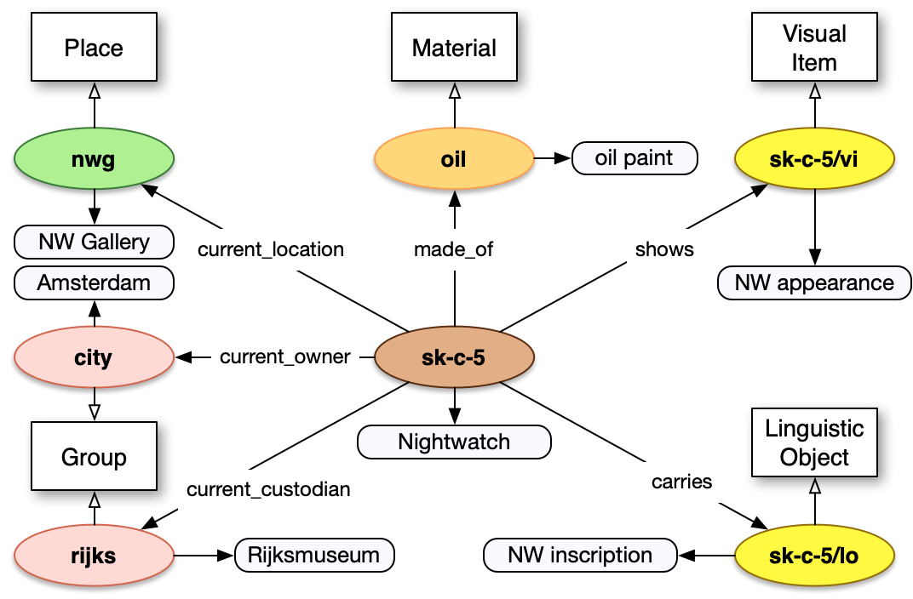
Physical Object
Notes:
Nightwatch: Owned by city of Amsterdam, Custodian: Rijksmuseum

Slide 65
Digital Object
access_point DigitalObject
digitally_available_via DigitalService
format (string with media type)
conforms_to InformationObject
digitally_carries LinguisticObject
digitally_shows VisualItem
(everything else has already been covered, remember!)

Slide 66
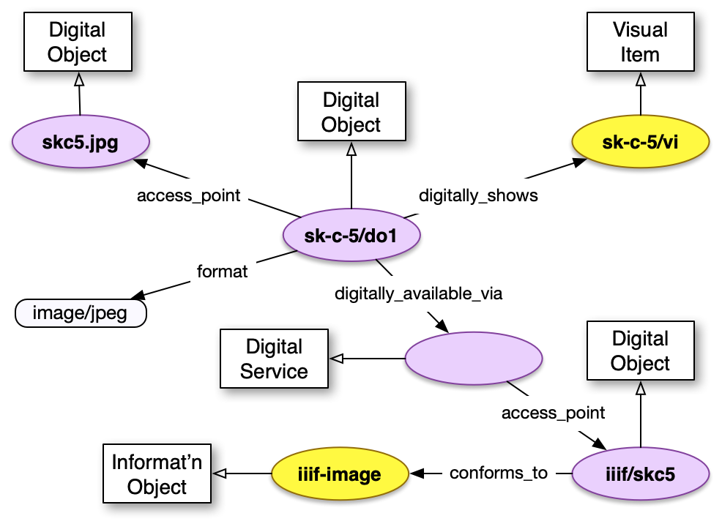
Digital Object

Slide 67
Textual Work
about (Any Entity)
subject_to Right
language Language
content (string with textual representation of work)
format (string with media type of content)
(I’m going to stop reminding you now that everything else was already covered, okay?)

Slide 68
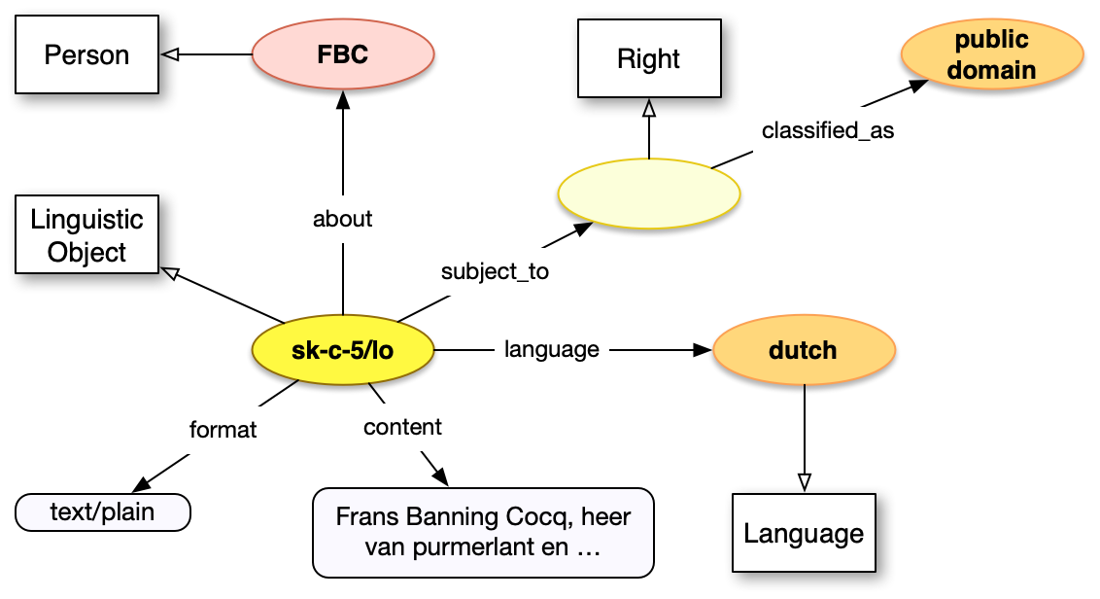
Textual Work

Slide 69
Visual Work
about (Any Entity)
subject_to Right
represents (Any Entity)
represents_entity_of_type Type

Slide 70
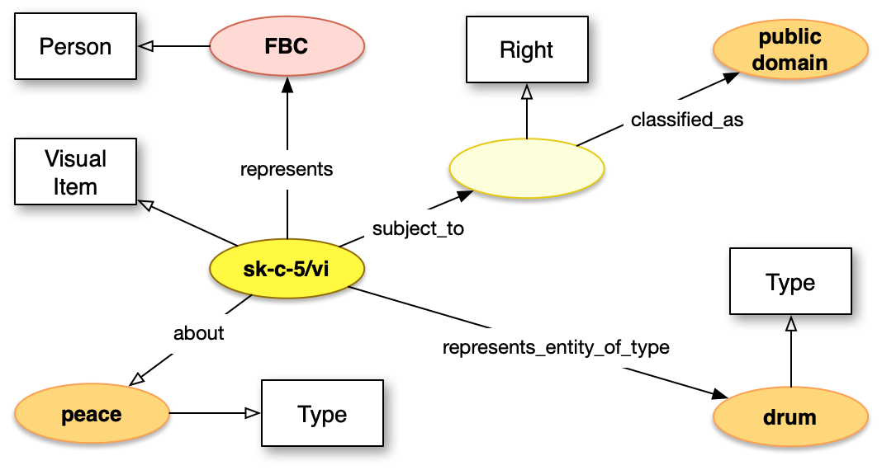
Visual Work

Slide 71
Person / Group
carried_out Activity
contact_point Identifier
residence Place

Slide 72
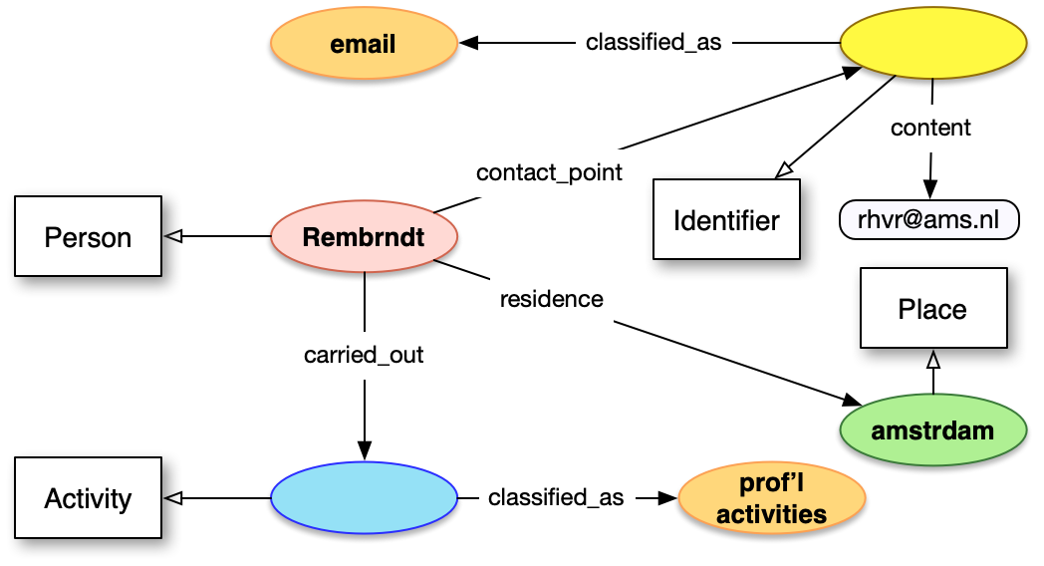
Person / Group

Slide 73
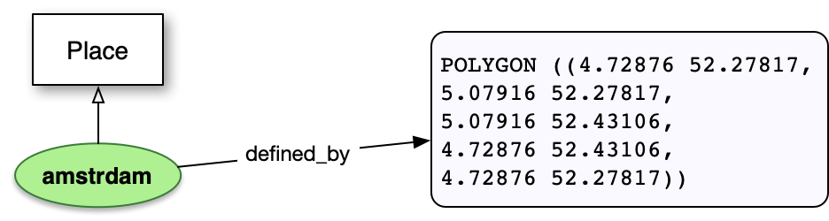
Place
defined_by (string with WKT formatted data)

Slide 74
Sets and Concepts
Only shared features :)

Slide 75
3.4. Take Home Summary
Most specific features are relationships to other classes
Minimal number of other features
Physical / Digital Objects have more, as core entities of interest. Digital are not core in underlying ontology
Works have rights and subjects
People and Places have identity features

Slide 76
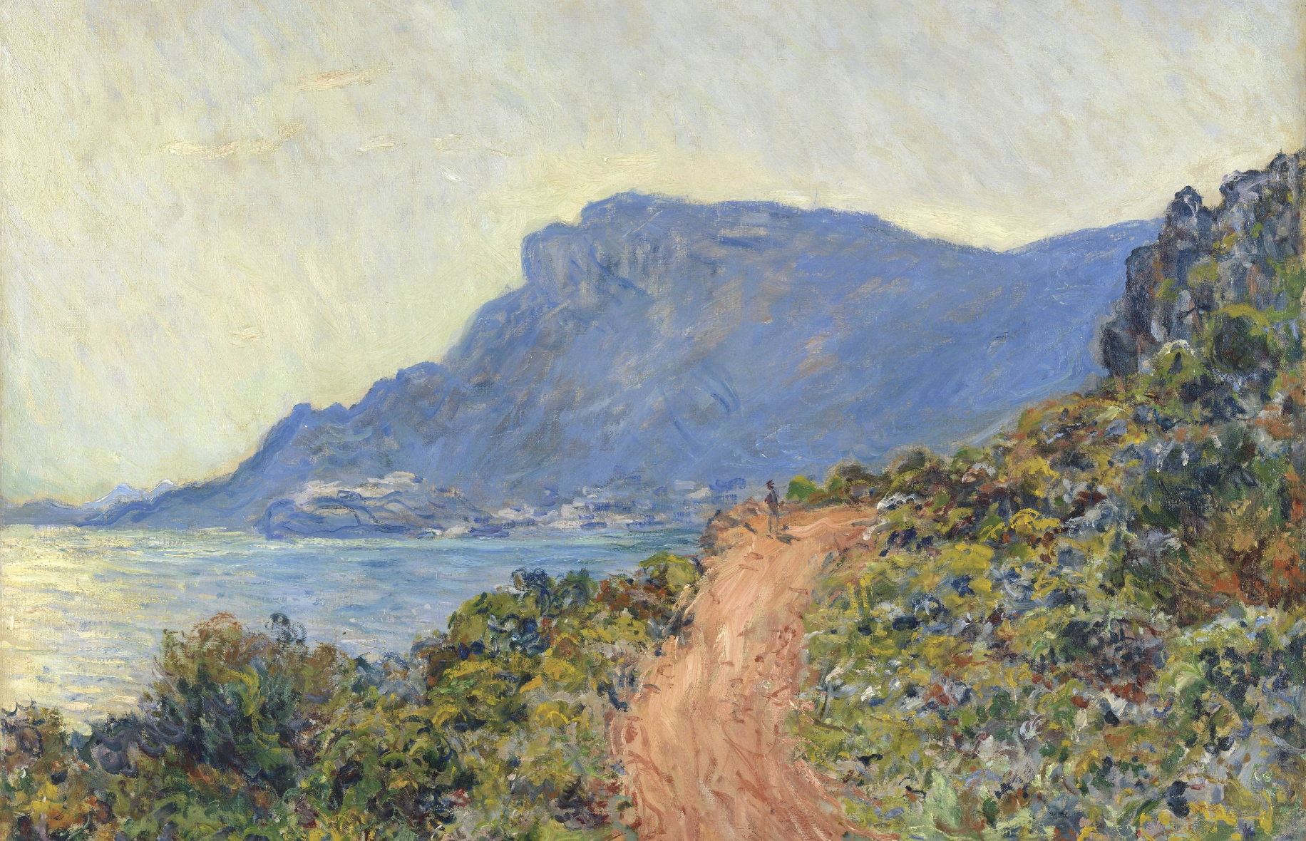
4. Exercise: Apply the Model!
https://www.rijksmuseum.nl/en/collection/SK-A-1892

Slide 77
5. APIs to Implement Linked Art
Web API Fundamentals
JSON-LD
Linked Art Records
HAL links
Activity Streams

Slide 78
Web API Fundamentals
URIs are Identifiers and Locators
URIs are Opaque – don’t infer from perceived structure
Please use HTTPS for all your URIs – even for open data
Interactions via HTTP
Use HTTP methods (GET, PUT, POST, DELETE)
LA only has Retrieve (GET), not Create, Update or Delete
“Don’t Fear the Network”

Slide 79
JSON-LD
Linked Art API responses are JSON-LD
Usability! Developers understand JSON
Semantics! It’s a full, round-trip-able RDF serialization
Can treat as a graph or a document or both
Context Document
Maps JSON keys and values into semantic space
Linked Art context is stable, breaking changes require a new major version, so can be aggressively cached
https://w3.org/TR/json-ld/

Slide 80
Linked Art Choices Simplify Records
Division of graph to records follows the major classes
No duplicate definitions across records
References are full URIs to ease client processing
Embedded structures do not have URIs
Context tries to simplify naming to be easier to remember
No @s, no numbers, no namespaces
CamelCase classes, snake_case properties
Remove inconsistently used is_ was_ has_ had_

Slide 81
Example Record
{
"@context": "https://linked.art/ns/v1/linked-art.json", "id": "https://rijks.nl/o/sk-c-5", "type": "HumanMadeObject", "_label": "Nightwatch",
"identified_by":[{ "type": "Name", "_label": "work name", "content": "The Night Watch",
"language": [{ "id": "https://vocab.getty.edu/aat/300388277", "type": "Language", "_label": "english" }]
}] }

Slide 82
Finding Back Links with HAL
Problem: We chose for object refers to the artist, but the artist doesn’t refer to their objects, when looking at the artist record, how do you know which objects they produced?
Naïve Answer: Search!
Problem: Standardizing search is impractical (cough sparql)
Answer: Hypertext Application Language link sets!
Problem: uhhh… hyper what now?

Slide 83
Finding Back Links with HAL
Separate the links needed for the API from the semantic data
Uses IETF standard (forthcoming, updated last week!)
Tooling including validation exists already
Add _links to the top level JSON object, that includes
Namespace declaration
Named links

Slide 84
HAL Links: Example
{
"id": "https://rijks.nl/p/rembrandt", "type": "Person", "_links": {
"curies": [{
"name": "la", "href": "https://linked.art/api/1.0/rels/{rel}", "templated": true }],
"la:agentProducedObject": { "href": "https://rijks.nl/p/rembrandt/producedObjects/1"
}
} }
https://datatracker.ietf.org/doc/html/draft-kelly-json-hal-10

Slide 85
Paging with Activity Streams
Standard response format when following the HAL links, and other scenarios
Profile of a W3C standard
Used by W3C Web Annotation, IIIF Change Discovery
Provides a common paging model and flexible system to reference entities
Same framework provides aggregation across collections
https://w3.org/TR/activitystreams-core
https://iiif.io/api/discovery/1.0/

Slide 86
Activity Streams Example
{
"@context": "https://linked.art/ns/v1/linked-art.json", "id": "https://rijks.nl/p/rembrandt/producedObjects/1", "type": "OrderedCollectionPage", "partOf": {"id": "…", "type": "OrderedCollection”}, "next" : {"id": "…", "type": "OrderedCollectionPage”}, "orderedItems": [ { "id": "https://rijks.nl/o/sk-c-5", "type": "HumanMadeObject"
}, {…}
]
}
https://w3.org/TR/activitystreams-core
https://iiif.io/api/discovery/1.0/

Slide 87
APIs Take Home Summary
JSON as syntax for audience – software developers
Linked Art records in JSON-LD
HAL links to provide “back links” via searches
ActivityStreams for search and aggregation
Important features: consistency, usability, easy to implement without specialized technologies, but still semantic knowledge
If you implement the APIs, you have implemented the model

Slide 88
Overall Summary
Linked Art is a metadata profile that selects appropriate features of other standards to define a model and set of web API functionality to implement
Usability, through consistent and developer friendly technology choices, is more important than precision and completeness
10 primary classes, several reusable components, a few class specific patterns to ensure semantic connections

Slide 89
Thank You!
https://linked.art/

